Slide 1
UML Activity Diagram
Dr. Bhavna Sareen
Assistant Professor
Department of Computer Science and Engineering
Chitkara University, Punjab

Slide 2
Introduction to Activity Diagram
In UML, the activity diagram is used to demonstrate the flow of control within the system rather than the implementation.
The activity diagram helps in envisioning the workflow from one activity to another.
It puts emphasis on the condition of flow and the order in which it occurs.
The flow can be sequential, branched, or concurrent, and to deal with such kinds of flows, the activity diagram has come up with a fork, join, etc.
It is also termed as an object-oriented flowchart.
It encompasses activities composed of a set of actions or operations that are applied to model the behavioral diagram.

Slide 3
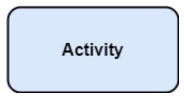
Basic Components of Activity Diagram
1. Activity
The categorization of behavior into one or more actions is termed as an activity.
In other words, it can be said that an activity is a network of nodes that are connected by edges.
The edges depict the flow of execution.
It may contain action nodes, control nodes, or object nodes.
The activities are initiated at the initial node and are terminated at the final node.

Slide 4
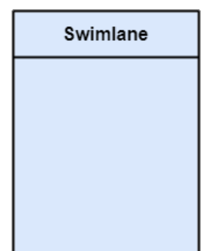
Basic Components of Activity Diagram
2. Activity Partition/Swimlane
The swimlane is used to cluster all the related activities in one column or one row.
It can be either vertical or horizontal.
It used to add modularity to the activity diagram.
It is not necessary to incorporate swimlane in the activity diagram. But it is used to add more transparency to the activity diagram.

Slide 5


Basic Components of Activity Diagram
3. Connector Symbol
Shows the directional flow or control flow of the activity.
An incoming arrow starts a step of an activity; once the step is completed, the flow continues with the outgoing arrow.
4. Decision Symbol
It represents a decision and always has at least two paths branching out with condition text to allow users to view options.
This symbol represents the branching or merging of various flows with the symbol acting as a frame or container

Slide 6
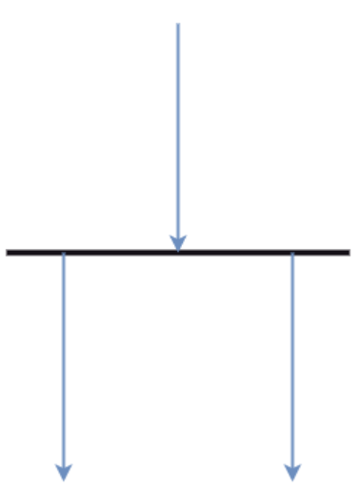
Basic Components of Activity Diagram
4. Forks
Forks generate the concurrent flow inside the activity.
A fork node consists of one inward edge and several outward edges.
It is the same as that of various decision parameters.
Whenever a data is received at an inward edge, it gets copied and split crossways various outward edges.
It split a single inward flow into multiple parallel flows.

Slide 7
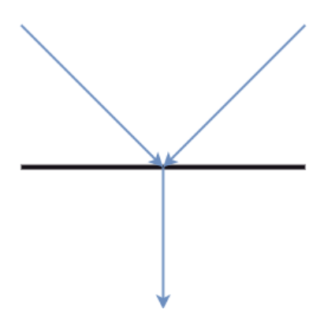
Basic Components of Activity Diagram
5. Join Nodes
Join nodes are the opposite of fork nodes.
A logical AND operation is performed on all of the inward edges as it synchronizes the flow of input across one single output (outward) edge.

Slide 8
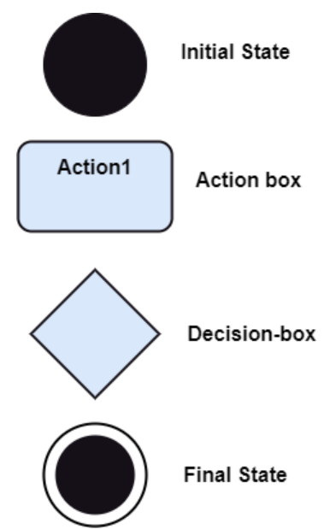
Notations of Activity Diagram
Initial State: It depicts the initial stage or beginning of the set of actions.
Action Box: It represents the set of actions that are to be performed.
Decision Box: It makes sure that the control flow or object flow will follow only one path.
Final State: It is the stage where all the control flows and object flows end.

Slide 9
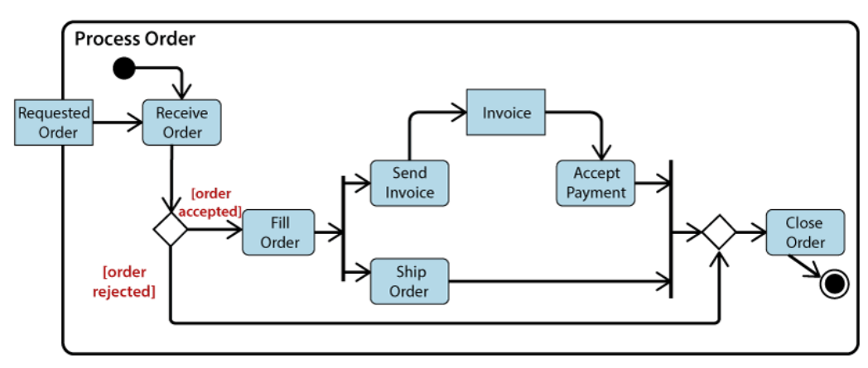
Activity Diagram Example – Order Processing System
Figure1. Example of Activity Diagram
Here the input parameter is the Requested order, and once the order is accepted, all of the required information is then filled, payment is also accepted, and then the order is shipped.
It permits order shipment before an invoice is sent or payment is completed.

Slide 10
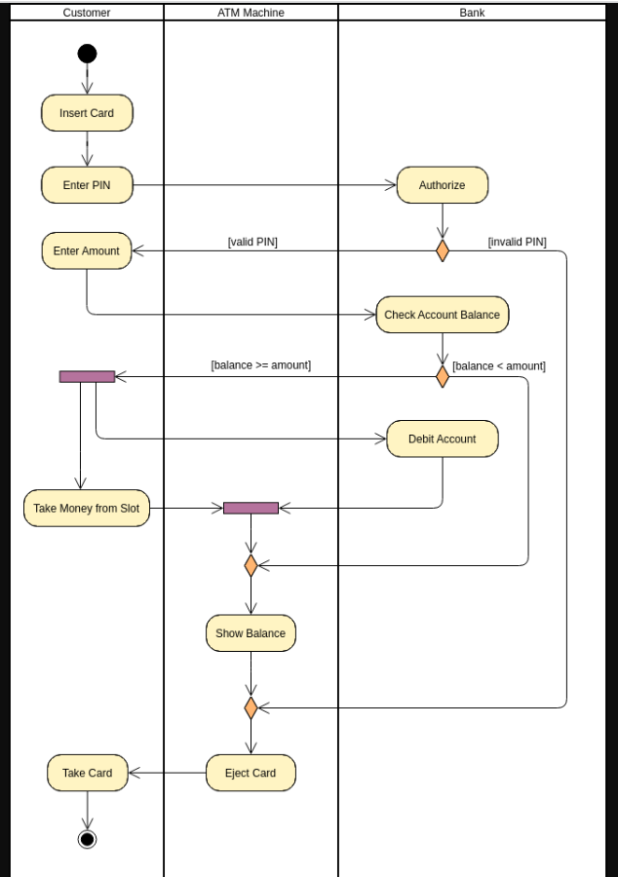
Activity Diagram Example – Banking System

Slide 11
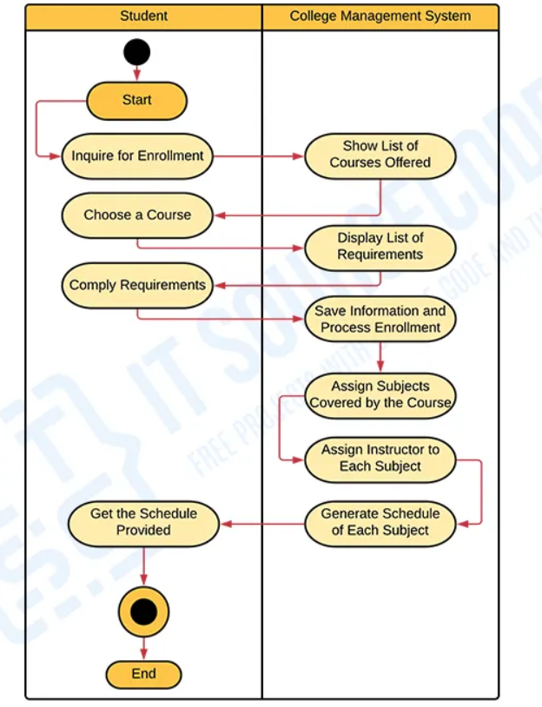
Activity Diagram Example – College Management System
Figure 3. College management system activity diagram

Slide 12
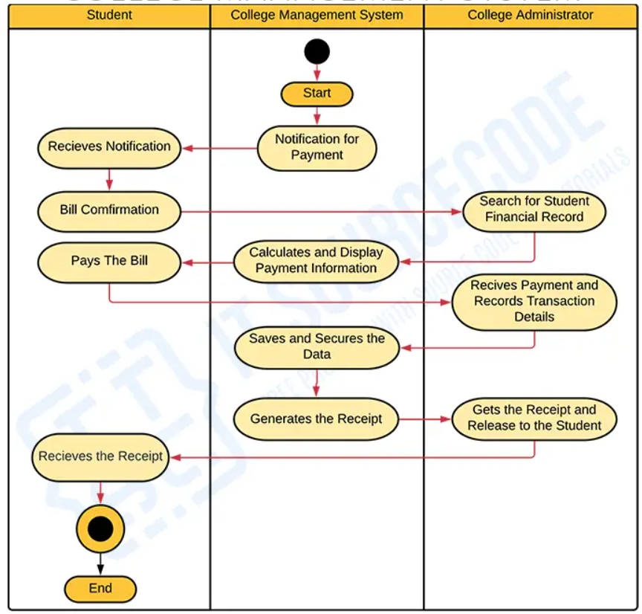
Activity Diagram Example – College Management System
Figure 4. College Management system Activity diagram

Slide 13
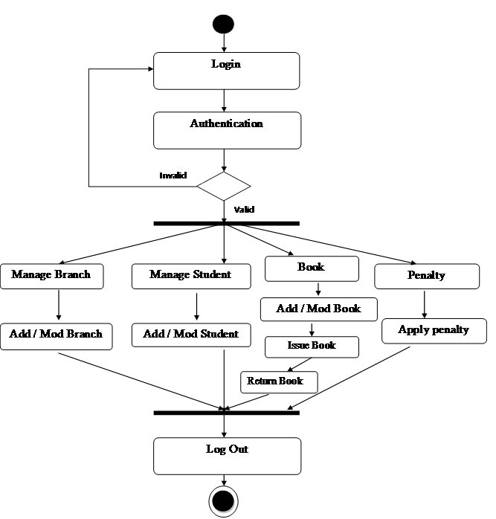
Activity Diagram Example – Library Management System
Figure 5. Activity diagram of Library Management System

Slide 14
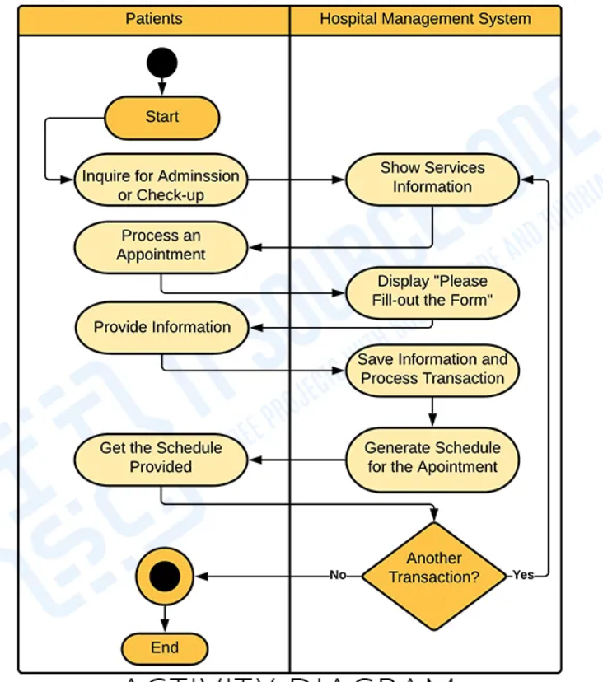
Activity Diagram Example – Hospital Management System

Slide 15
Benefits of Activity Diagrams
Activity diagrams present a number of benefits to users. Consider creating an activity diagram to:
Demonstrate the logic of an algorithm.
Describe the steps performed in a UML use case.
Illustrate a business process or workflow between users and the system.
Simplify and improve any process by clarifying complicated use cases.
Model software architecture elements, such as method, function, and operation.

Slide 16
When to use Activity Diagram
An activity diagram can be used to portray business processes and workflows.
Also, it used for modeling business as well as the software.
An activity diagram is utilized for the followings:
To graphically model the workflow in an easier and understandable way.
To model the execution flow among several activities.
To model comprehensive information of a function or an algorithm employed within the system.
To model the business process and its workflow.
To envision the dynamic aspect of a system.
To generate the top-level flowcharts for representing the workflow of an application.
To represent a high-level view of a distributed or an object-oriented system.

Slide 17
Bug Removal
Software testing is the process of verifying that a software product or application is doing what it is supposed to do. The benefits of testing include preventing distractions, reducing development costs, and improving performance.
A malfunction in the software/system is an error that may cause components or the system to fail to perform its required functions. In other words, an error encountered during the test can cause malfunction. For example, incorrect data description, statements, input data, design, etc.

Slide 18
Bug Removal
There are many different types of software testing, each with specific goals and strategies. Some of them are below:
Acceptance Testing: Ensuring that the whole system works as intended.
Integration Testing: Ensuring that software components or functions work together.
Unit Testing: To ensure that each software unit operates as expected. The unit is a testable component of the application.
Functional Testing: Evaluating activities by imitating business conditions, based on operational requirements. Checking the black box is a common way to confirm tasks.
Performance Testing: A test of how the software works under various operating loads. Load testing, for example, is used to assess performance under real-life load conditions.

Slide 19
MCQ based question for practice
1. What is the primary purpose of an activity diagram in UML?
To show the flow of control or data in a system
To represent the static structure of a system
To depict the sequence of events in a use case
To describe the interactions between different actors
2. Which symbol is used to represent the start of an activity in an activity diagram?
Rounded rectangle B) Circle C) Diamond D) Filled circle
3. Which of the following best represents the flow of control between activities in an activity diagram?
A) Dashed line with an arrowhead B) Solid line with an arrowhead C) Solid line with no arrowhead D) Dashed line with no arrowhead

Slide 20
MCQ based question for practice
4. What does an activity final node represent in an activity diagram?
The end of a single activity B) The final state of an object C) The end of all activities in a flow D) The condition for decision-making
5. In an activity diagram, which of the following would most likely represent a waiting action or a pause in the flow?
Activity node B) Decision node C) Fork node D) Initial node
6. In an activity diagram, which of the following is used to show parallel activities?
A) Fork node B) Decision node C) Merge node D) Join node

Slide 21
THANKS

